Slide 1
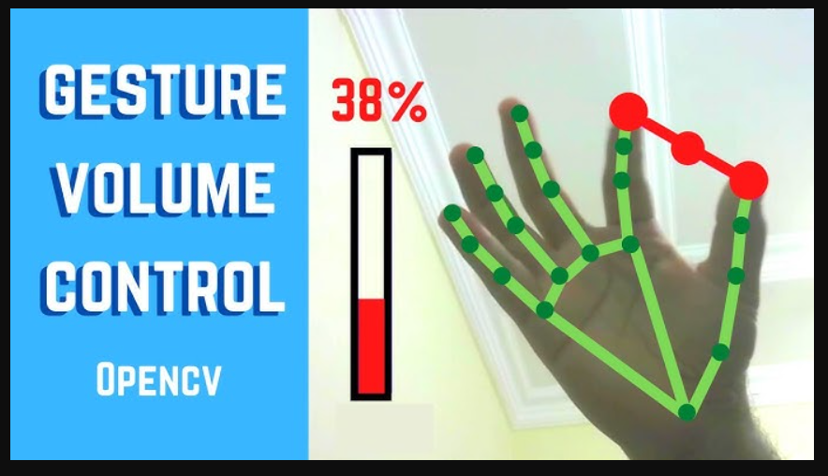
Controlling Volume with Hand Gestures using a Webcam
OpenCV and Mediapipe
By - Gautam N Chipkar

Slide 2
Milestone 1 : The webcam feed will be integrated into the application using OpenCV.
The webcam feed will be integrated into the application using OpenCV.
MediaPipe Hands will be implemented to detect hands and extract landmark coordinates in real time.

Slide 3
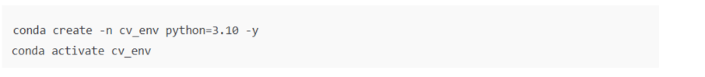
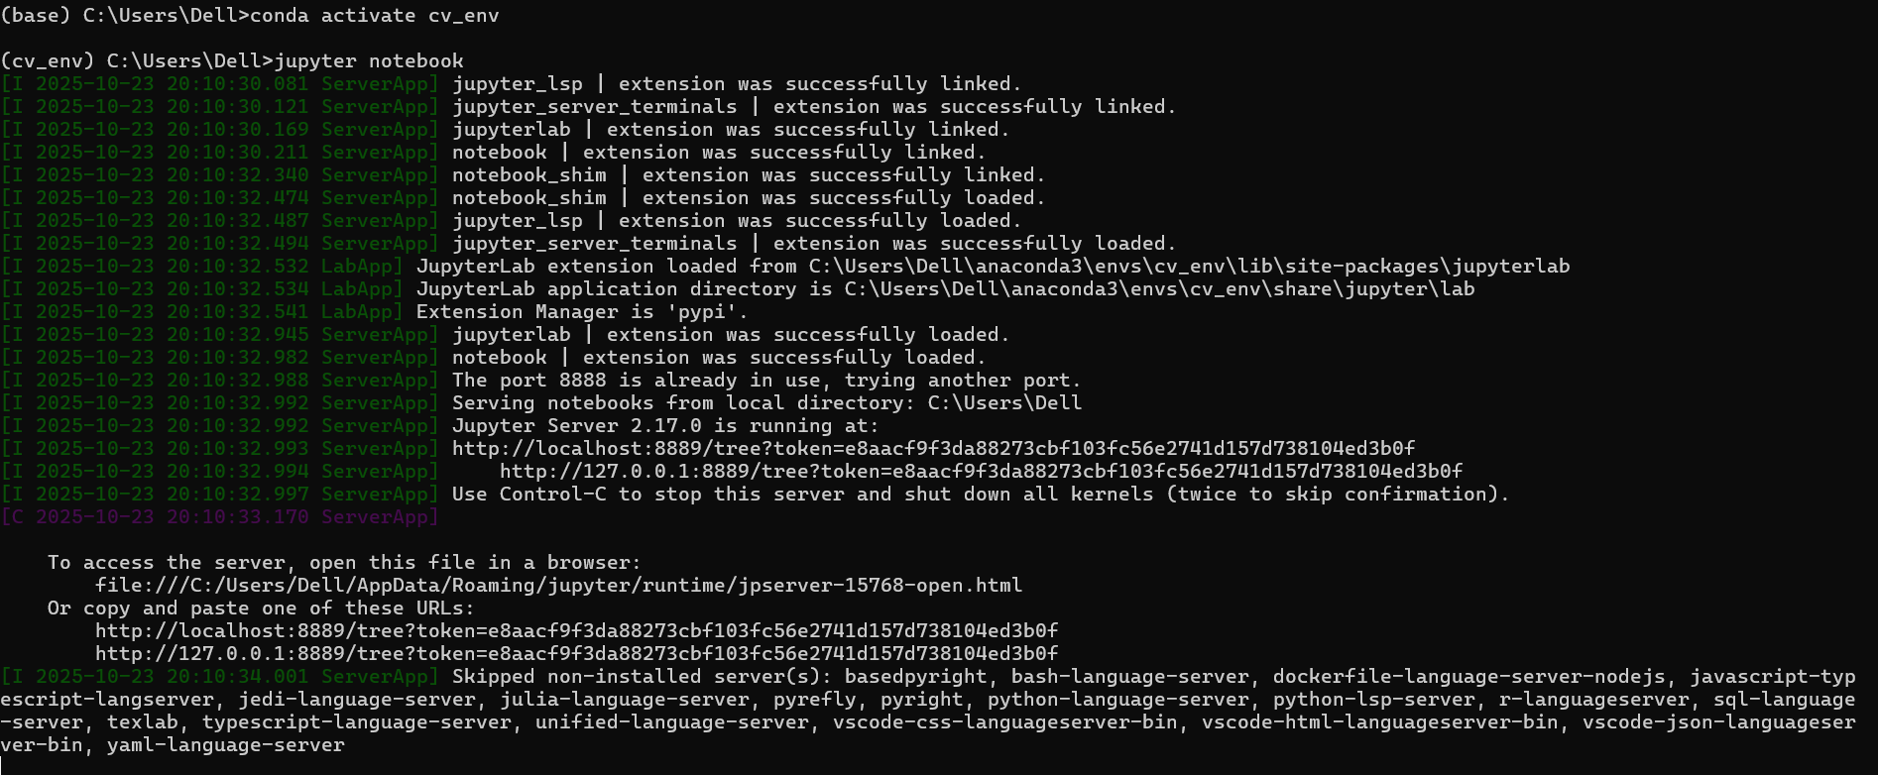
Setting up Environment :
Installing Python 3.10
Activating the environment and using it :

Slide 4
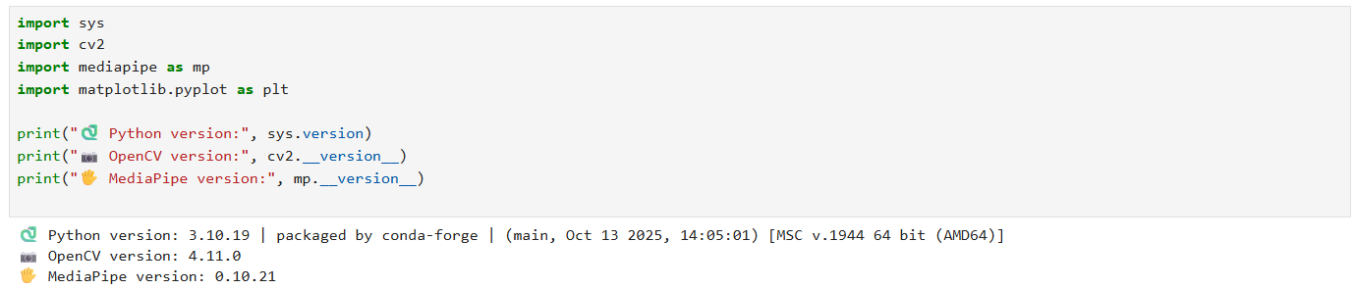
Checking if requirements are reached
Python 3.10
OpenCV library Installed
Mediapipe library Installed

Slide 5
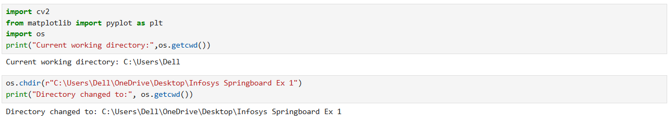
- Setting up Working Directory :
Initial Directory ( null) → Changed Directory ( Infosys Springboard Ex 1)

Slide 6
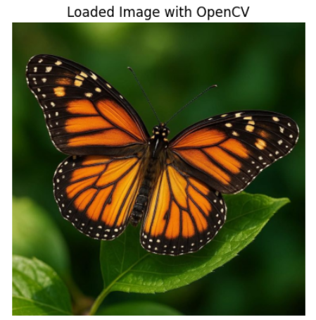
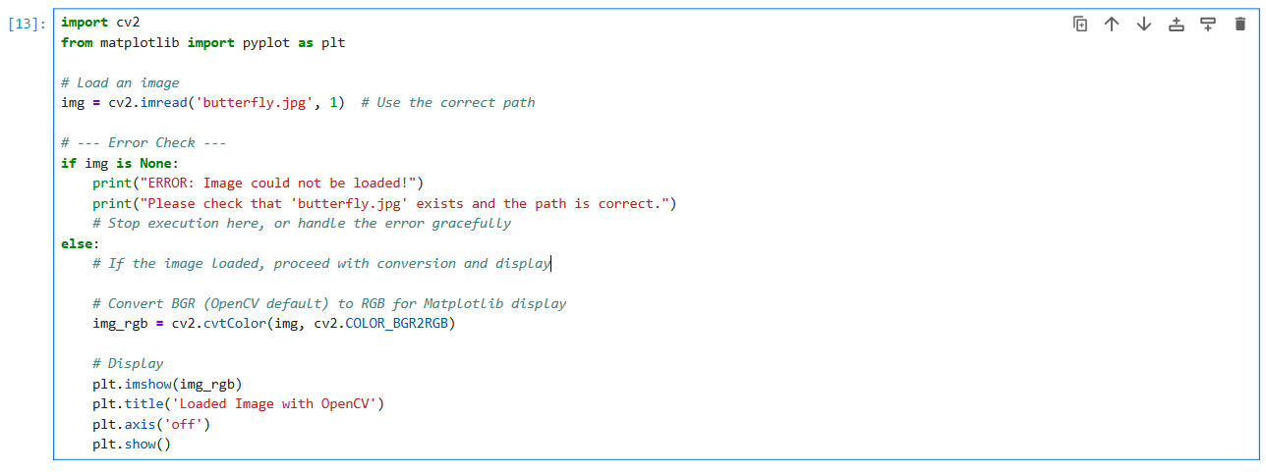
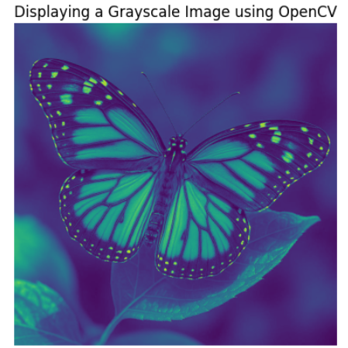
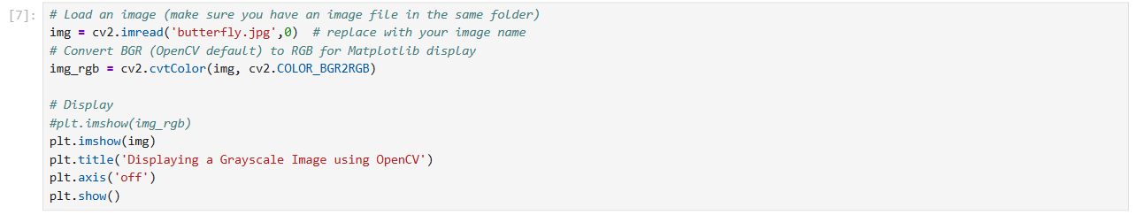
“Loading and Displaying an Image using OpenCV”
“Loading and Displaying a Grayscale Image using OpenCV”

Slide 7
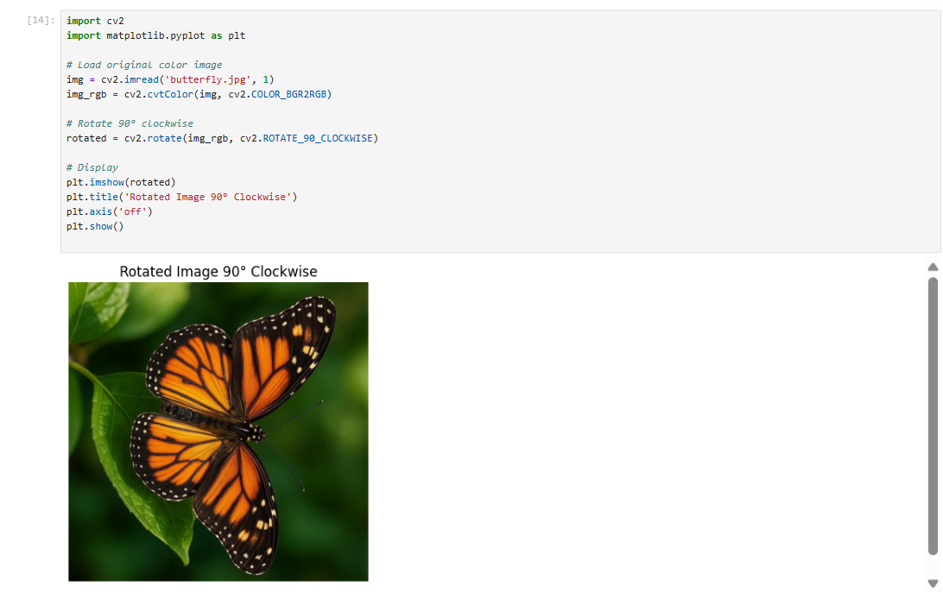
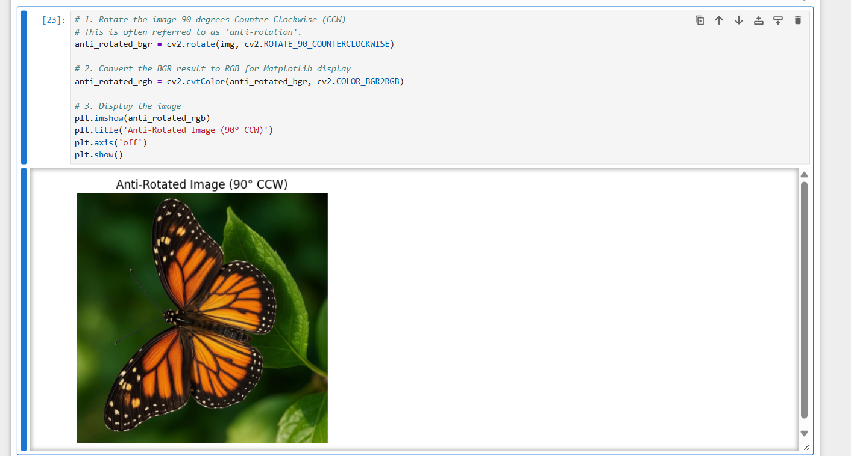
Rotating Images both Clockwise and Anti-Clockwise

Slide 8
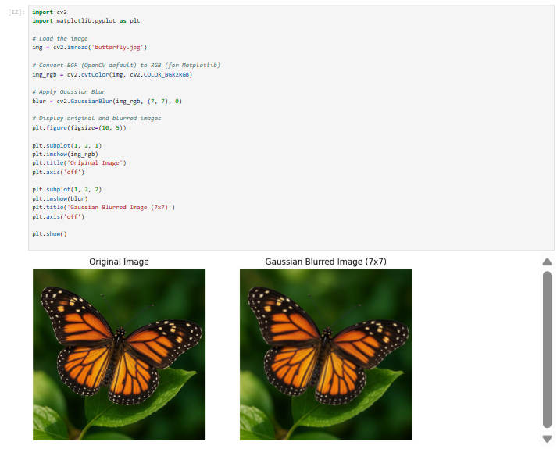
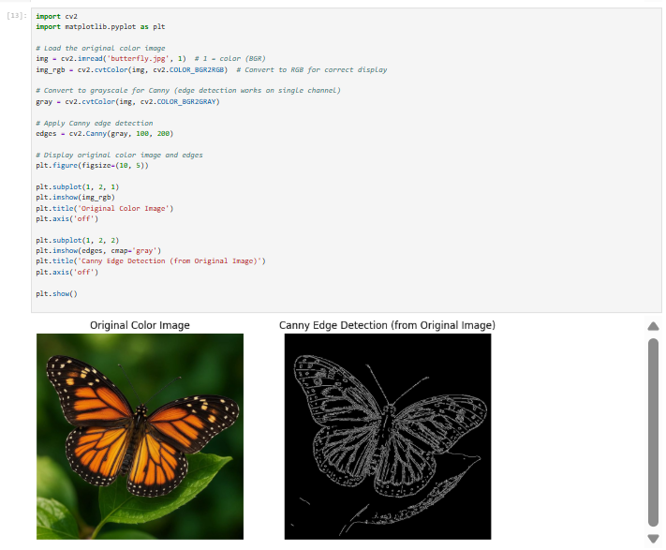
IMAGE PROCESSING TECHNIQUES :

Slide 9
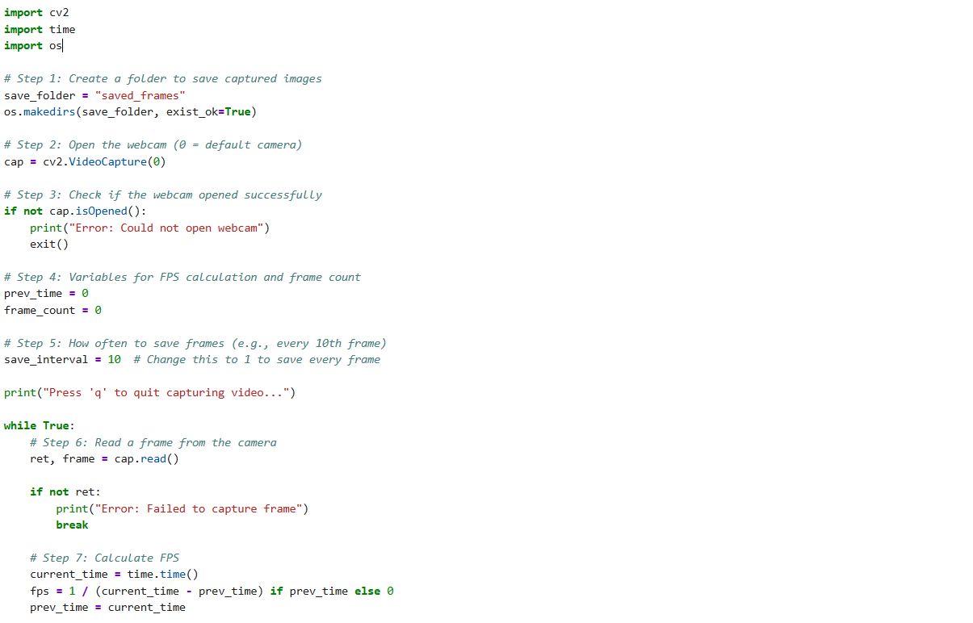
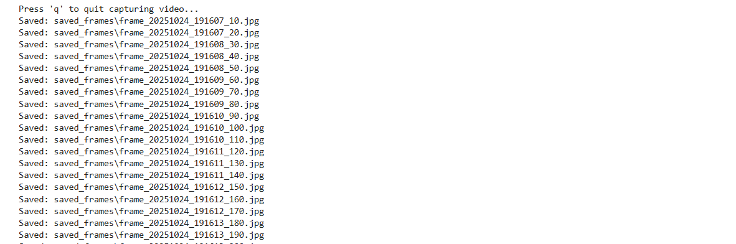
Capture Video Frames from Webcam and Save as Images using OpenCV

Slide 10
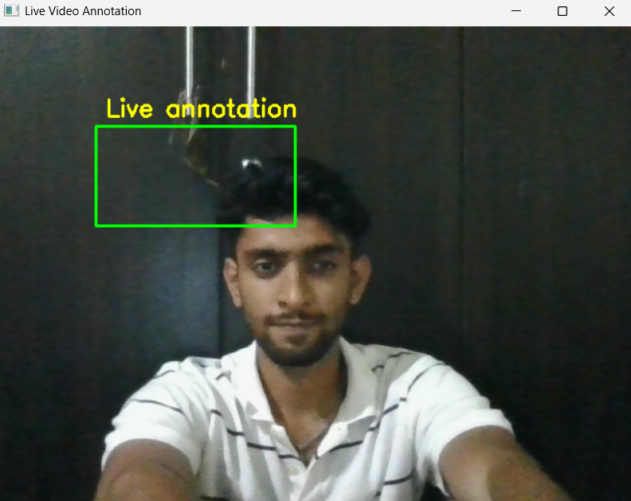
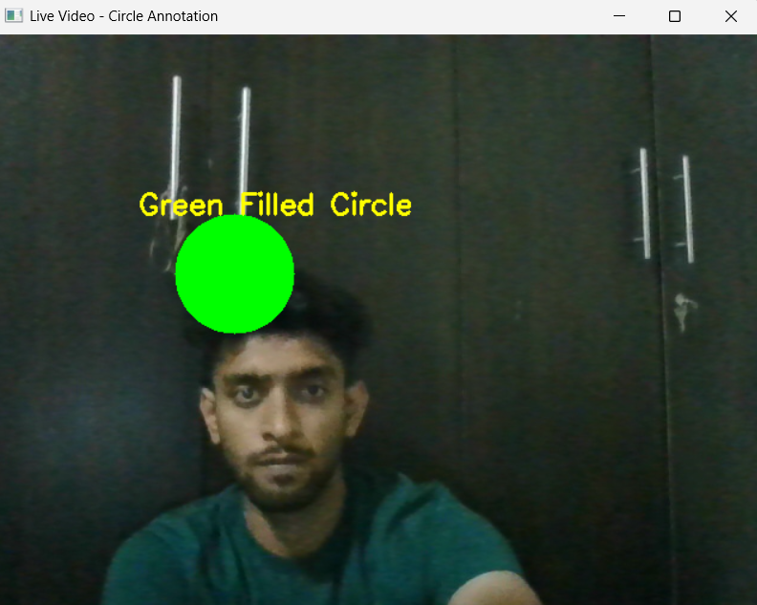
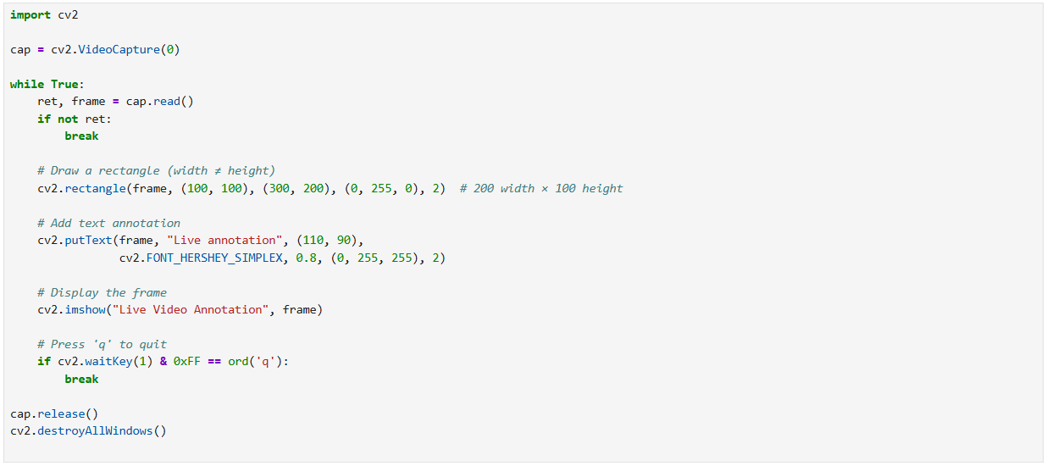
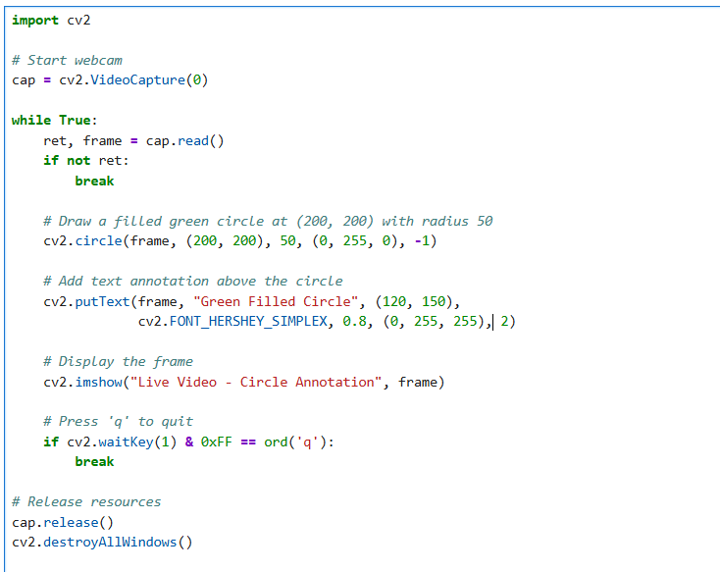
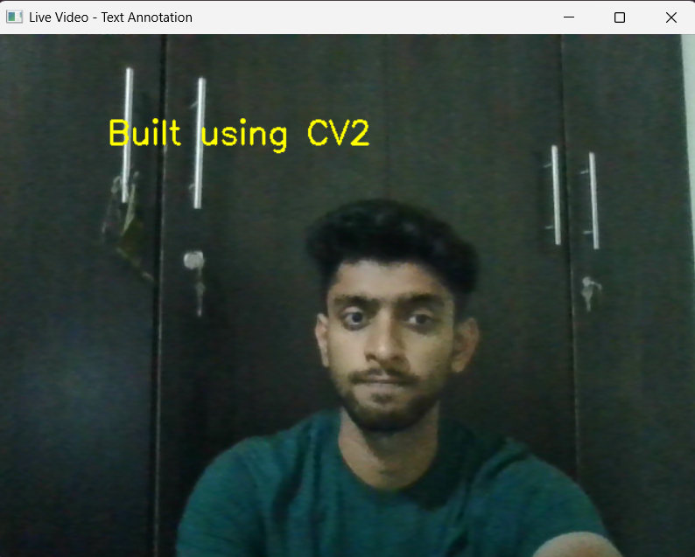
Drawing object like rectangle , circle and text (stroke and filled)

Slide 11
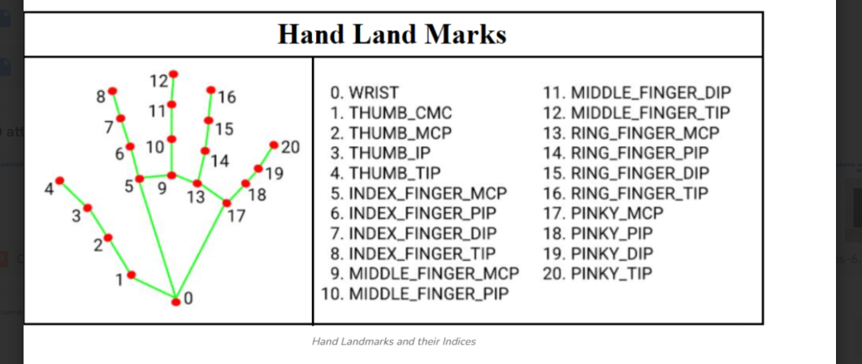
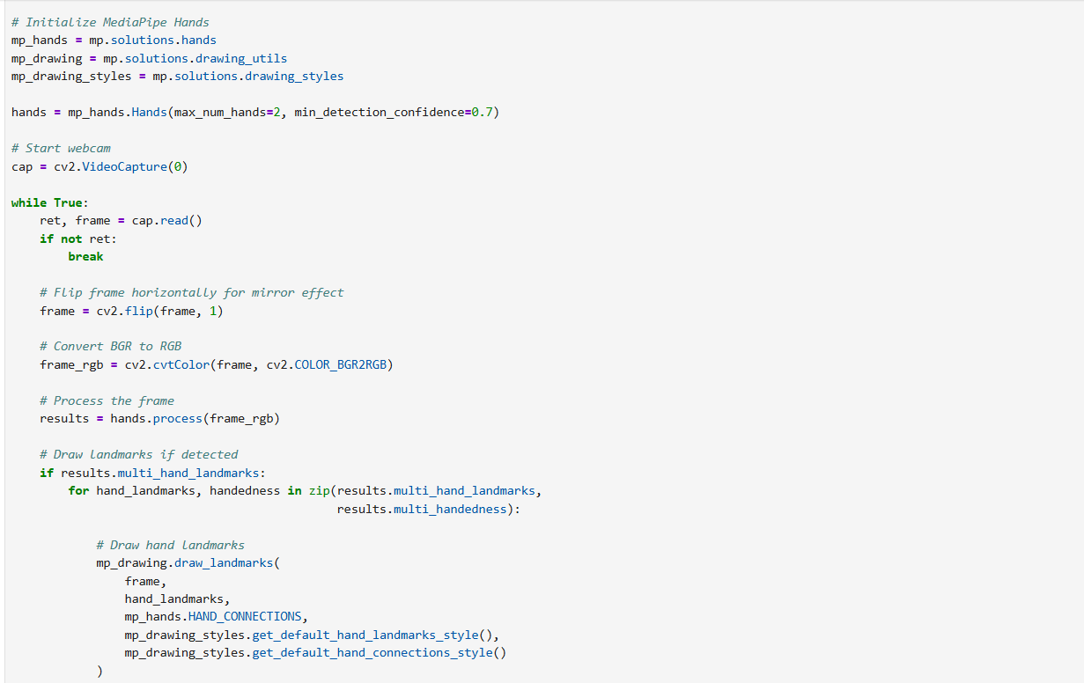
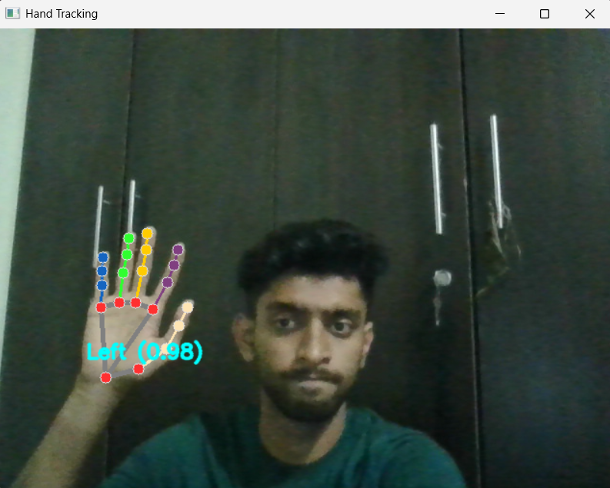
“Real-Time Hand Tracking using MediaPipe and OpenCV”

